Slide 1
Stem Cell Engineering Informatics in 2015
Status of LIMS2, HTGT and WGE systems
David Parry-Smith
17 March 2015

Slide 2
Talk Outline
What are we trying to achieve with our systems?
Overall landscape of systems
HTGT – legacy but still used
LIMS2 – the current LIMS still actively developed
WGE – a research tool for CRISPR genome editing
Documentation
Future plans
People

Slide 3
What are we aiming to achieve?
Tracking systems for wells that are manipulated in the lab
Tools for reporting over those wells
Tools for engineering designs
Tools for designing, tracking and reporting CRISPR experiments

Slide 4
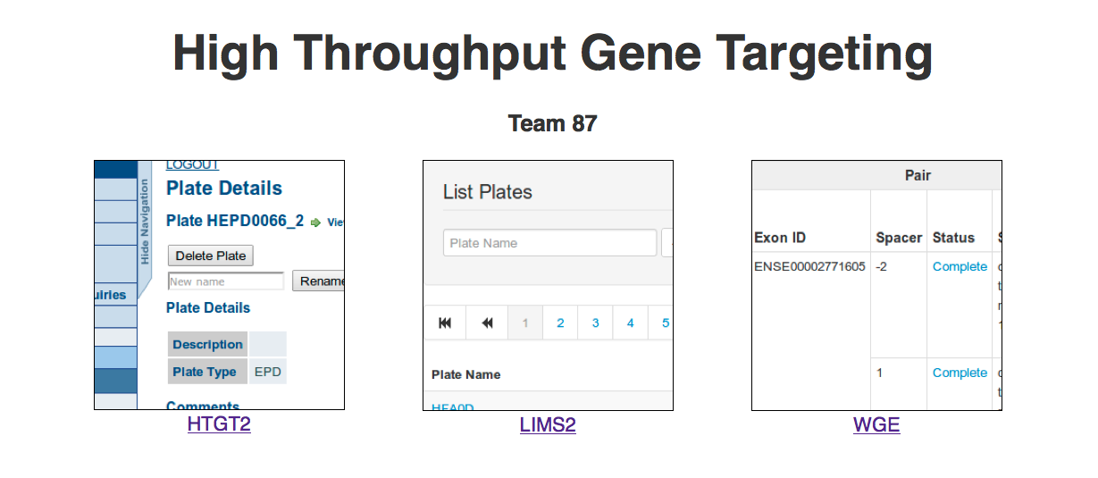
The Landscape
URL: www.sanger.ac.uk/htgt

Slide 5
HTGT
HTGT – High-Throughput Gene Targeting
The ‘original’ LIMS for Team87
Perl/Catalyst/DBI/DBIx::Class/Oracle
Catalyst 5.90042
Was running on Etch (aka ancient version of Debian)
A ‘legacy’ system supporting Mouse (only)
Essentially relational ‘one well -> one parent’ model
A kind of informal tree structure

Slide 6
HTGT2 – The migration
Removal of systems support for Etch O/S (summer 2013)
drives effort to migrate to Ubuntu Precise (VMs)
The painstaking task of gathering all Perl modules required:
Local – multiple subversion repositories re-organised into handful of GIT repositories (using GIT submodules)
htgt-root
htgt-batch
htgt-app
CPAN modules for Perl 5.14.4 …

Slide 7
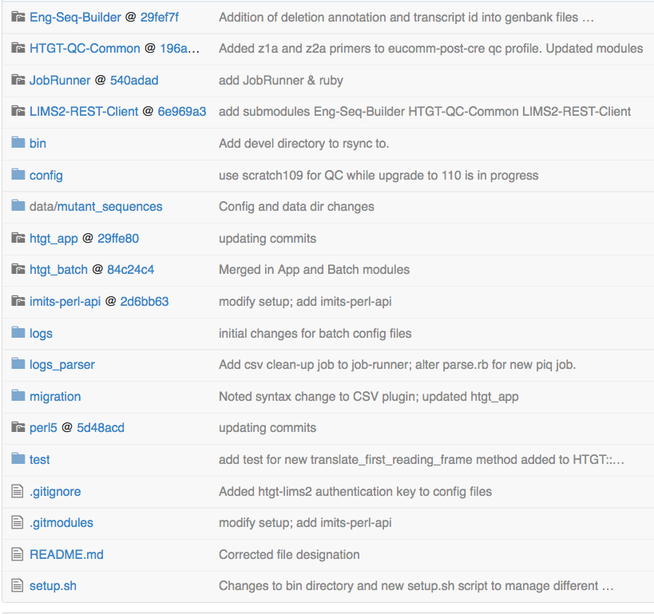
HTGT2 code repo

Slide 8
LIMS2
Supports:
both Human and Mouse species
Gibson Designs
CRISPR/Cas9 support
Runs on Ubuntu 10.04 (Lucid lynx)
Perl 5.10.1 (…old!)
Catalyst/DBIx::Class/PostgreSQL
Catalyst 5.90011
More use of JavaScript
ExtJS for flexible table widget
Genoverse genome browser

Slide 9
LIMS2 - architecture
A well can have … multiple parent wells!
Re-arrays, extensive parameter validation
Access the DB through the model.
Thin controller/fat model.
Shares QC system with HTGT2
For Farm3 submission
Directed Acyclic Graph
Graph Support is limited in DBIx::Class and ANSI SQL
‘WITH RECURSIVE’ required in PostgreSQL to permit searching across the graph
No support in DBIx::Class … yet
Required for fast reporting

Slide 10
Recent features
Automatic genotyping/PCR/sequencing primer generation
JavaScript trace viewer for Sequencing QC review
CRISPR QC
Bar coding check-in/check-out and tracking
Plate versioning required as a result

Slide 11
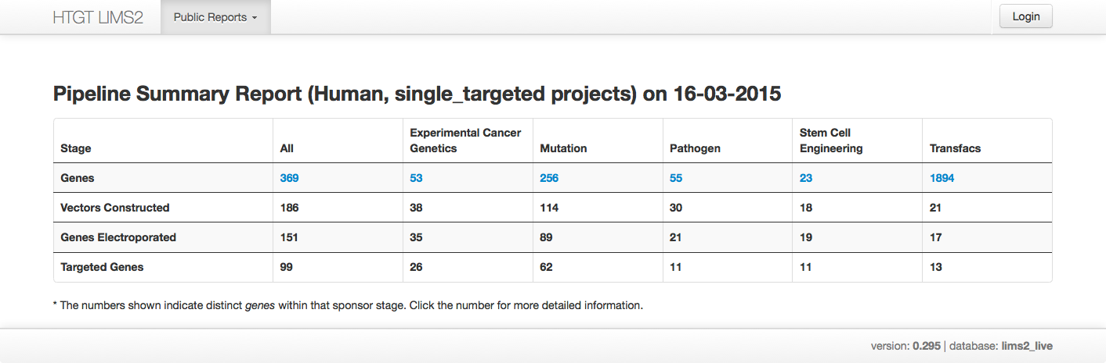
LIMS2 Public Access

Slide 12
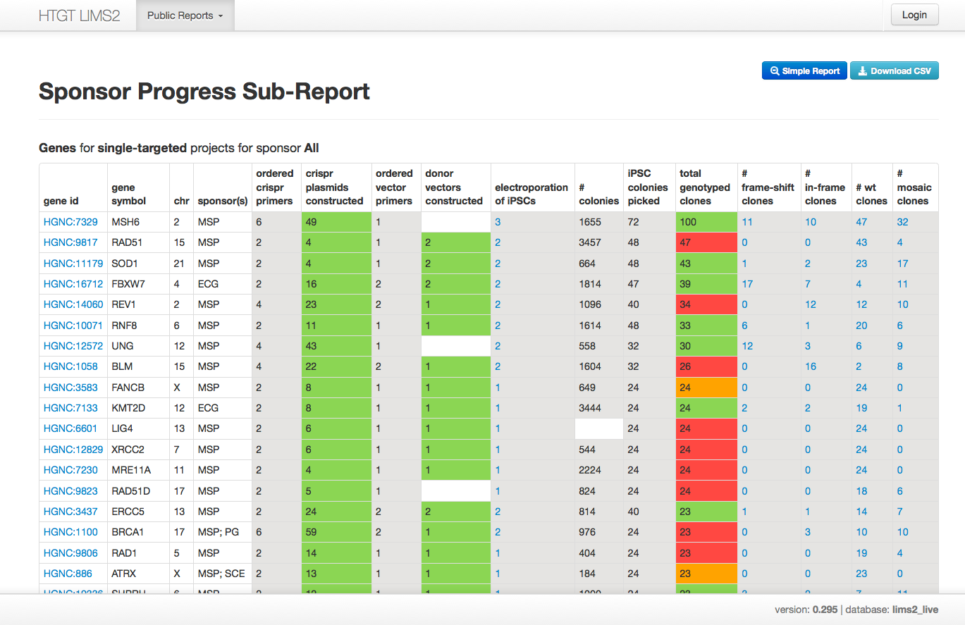
Drill down …

Slide 13
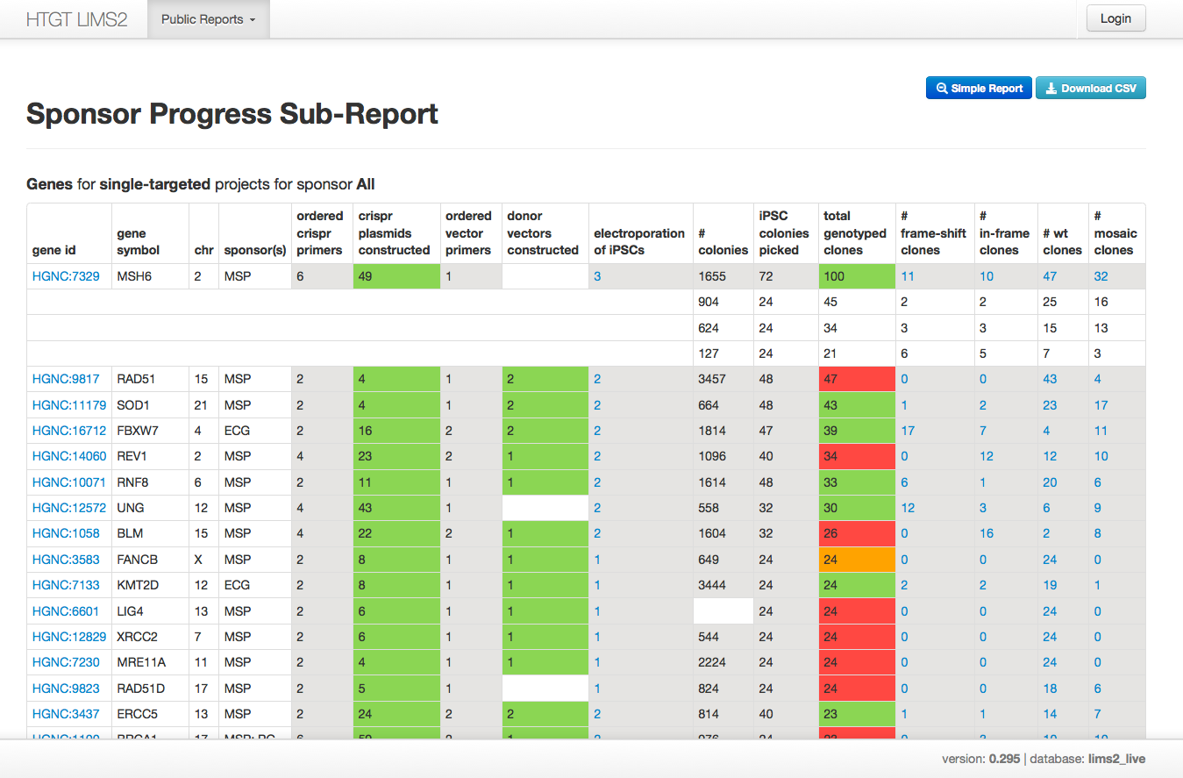
… and fine detail

Slide 14
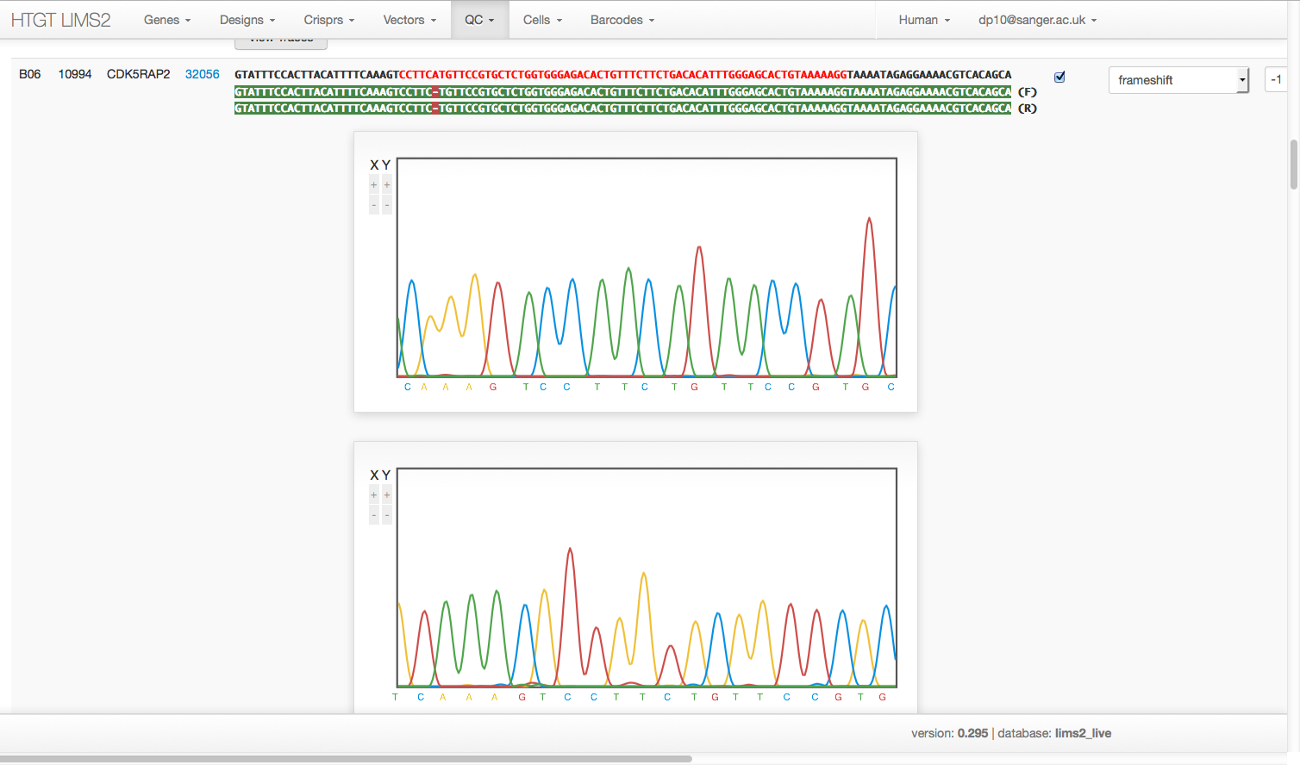
CRISPR QC Trace Viewer

Slide 15
How much data?
LIMS2 is a well-relationship system
As of today:
412,157 wells
20,000 design genes
Mouse 17,780*
Human 1,987
*Does not include data in HTGT2 that is not included in LIMS2

Slide 16
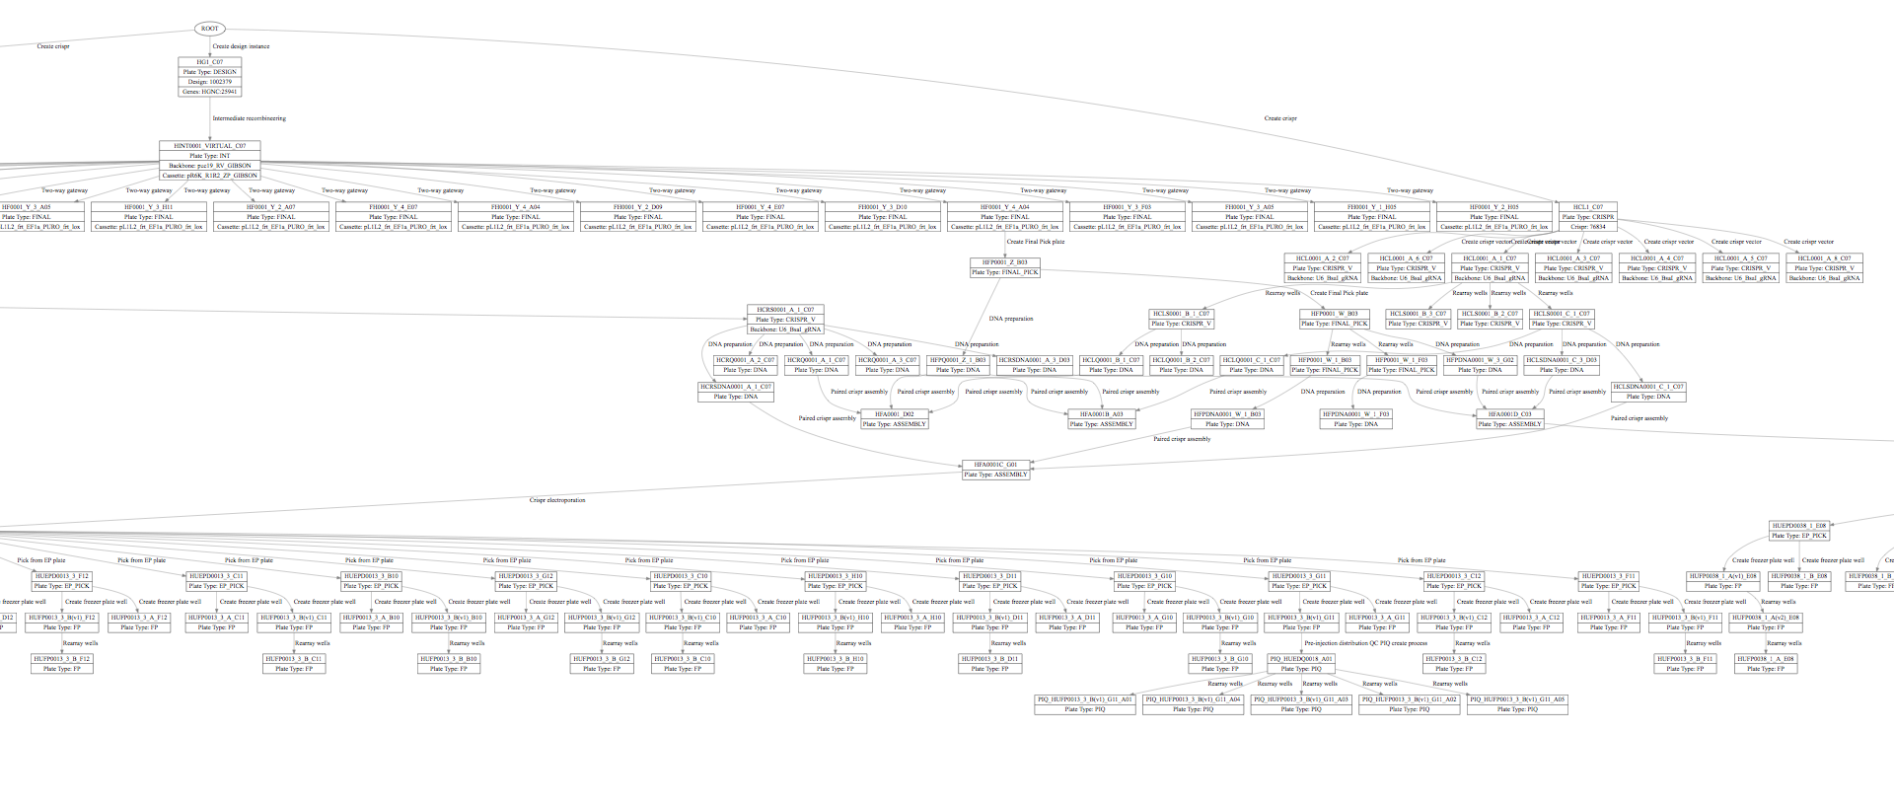
How it looks to LIMS2

Slide 17
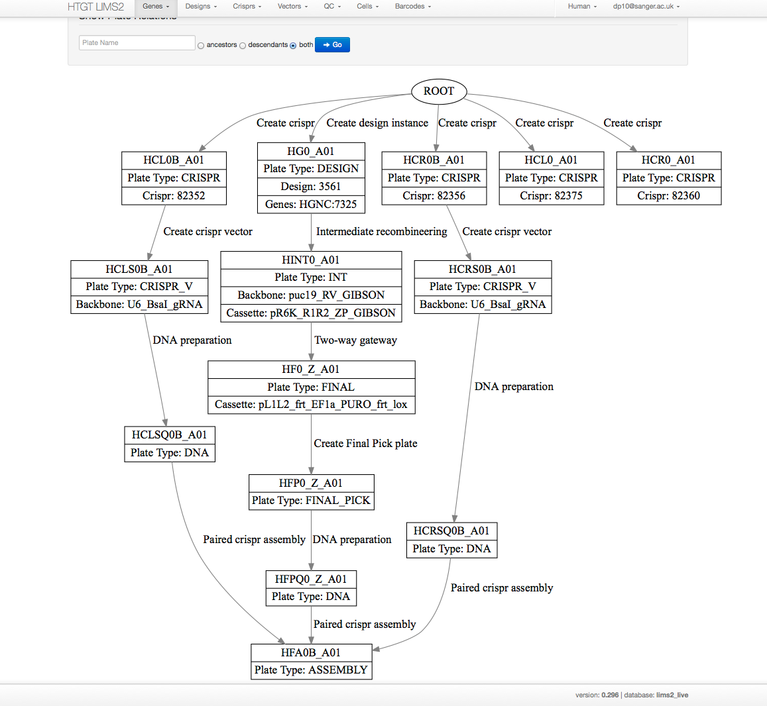
A simpler example

Slide 18
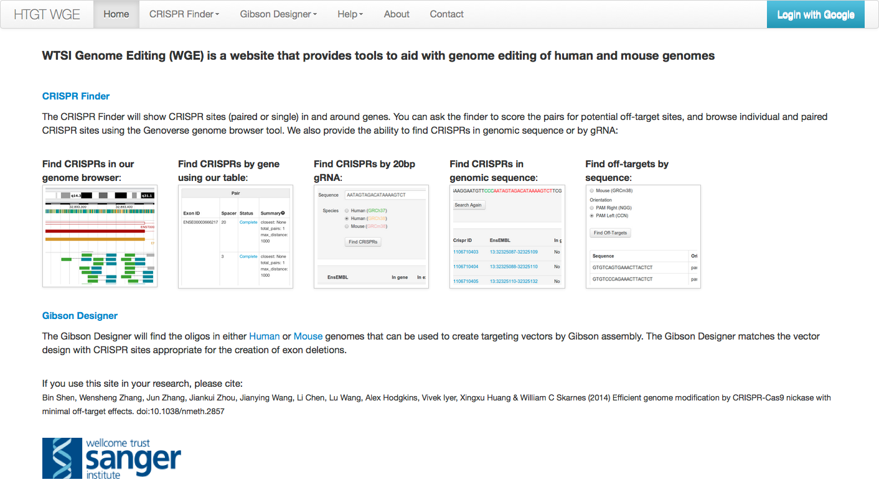
WGE

Slide 19
WGE - Implementation
Originally a Dancer app
Now a Perl/Catalyst/DBIx::Class/PostgreSQL app
Genome browser interface to a database of CRISPR sites in the Human and Mouse genomes (novel!)
Uses an in memory index served by separate server
Off-targets are calculated and stored
mouse and human exomes (+ 200 bp flank)
batch mode or via genome browser interface

Slide 20
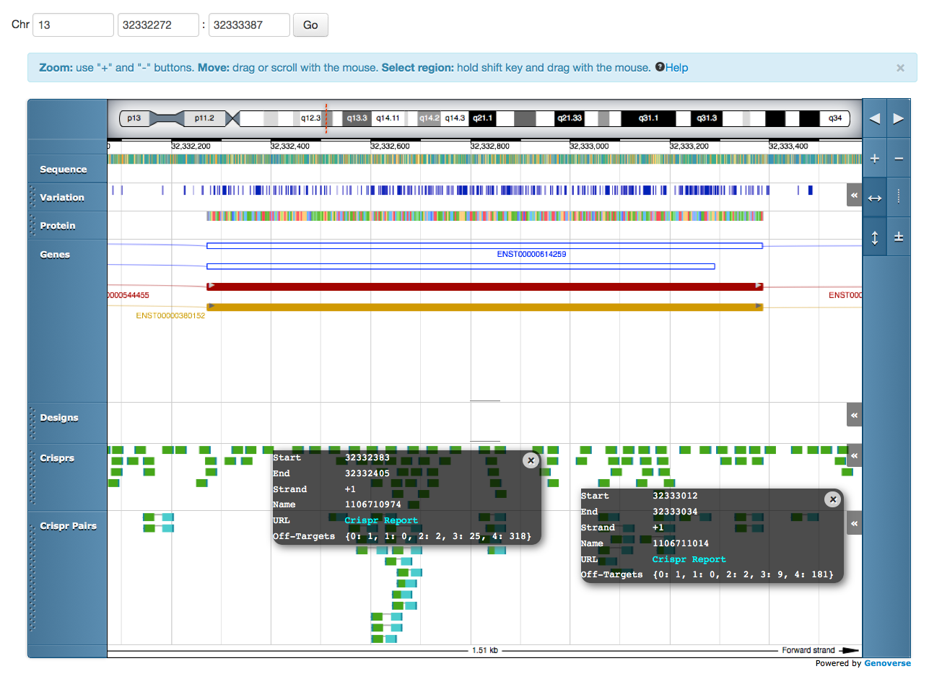
WGE Genoverse Genome Browser

Slide 21
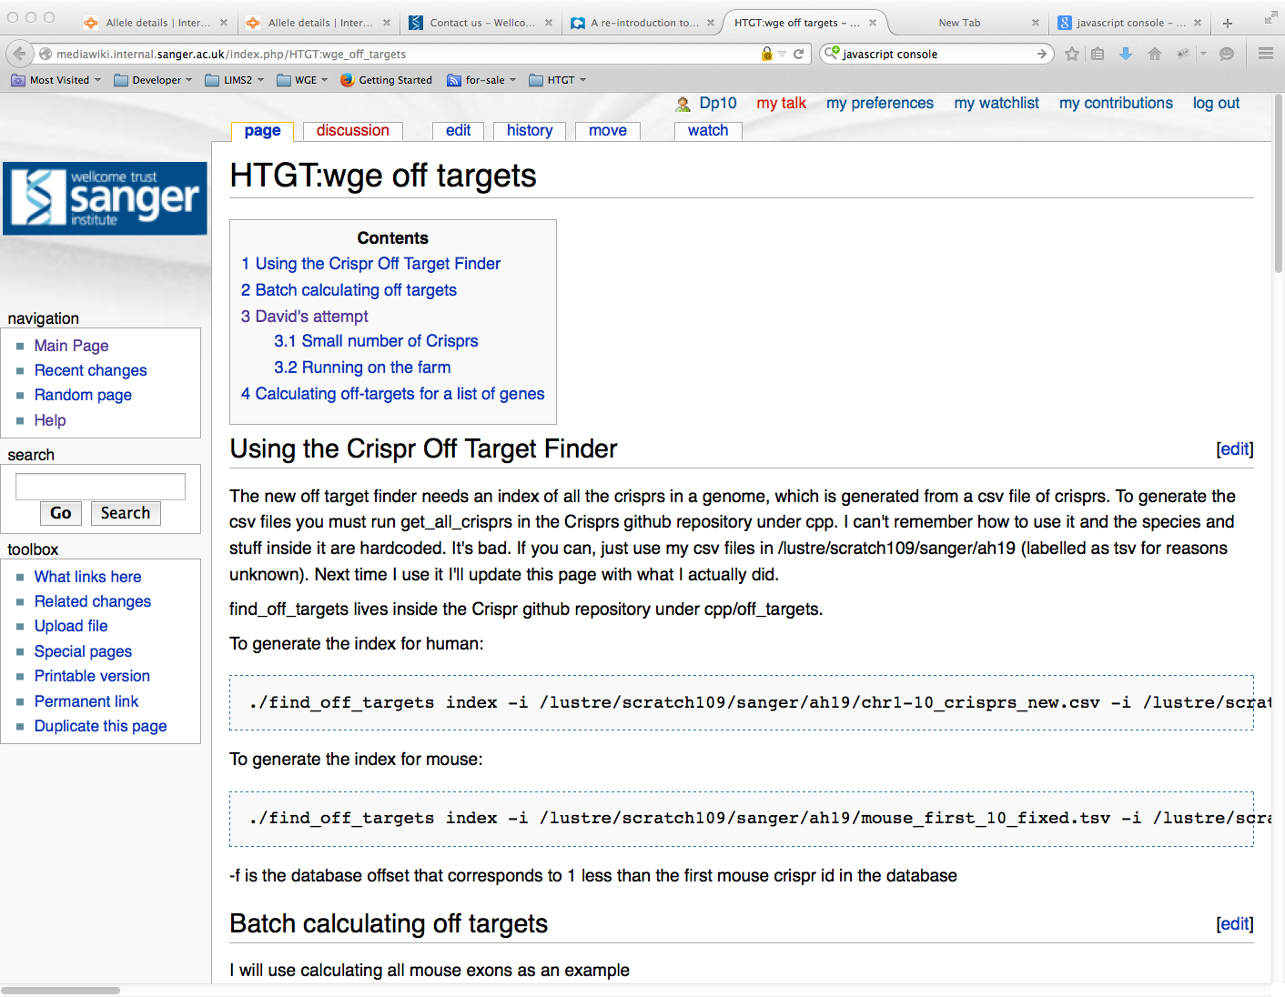
Wiki Documentation

Slide 22
Future Plans
Prepare users for the move to read-only HTGT
Migration of LIMS2 to Ubuntu 12.04 or (preferably) 14.04
Review of Deployment strategy for LIMS2 and WGE
Currently bespoke
Consideration of publicly available tools
Puppet, Chef etc.
Extend functions of LIMS2 as a tracking system driven by user requirements

Slide 23
People
Informatics Group 2015
Anna Farne
Tiago Grego
David Parry-Smith
Saj Pereira
Ex-members
Andrew Sparkes
Alex Hodgkins
Richard Easty
Vivek Iyer
New role – Imits lead
Peter Matthews
Scientists
Wendy Bushell
Barry Rosen
Mark Thomas
Bill Skarnes

